Slide 1
IBM Digital Business Automation Embedding a predictive model in ODM Pierre Berlandier

Slide 2
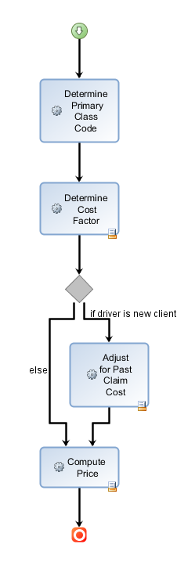
Use case: ACME Auto Insurance
ACME is pricing its policy applications using the following process:
It determines a base cost factor associated with a primary class code. The class code is derived by a decision table, based on the driver’s gender, marital status, age, and other characteristics (principal operator of the vehicle, driver is owner of the vehicle, driver is away to school, etc.)
If the application is not from an existing client, it uses a predictive model to estimate the cost of the past claims of the driver based on gender, the type of area where she or he lives, and other parameters. Based on the cost of past claims, a possible surcharge is determined by a decision table and added to the base cost factor.
If the driver is eligible, the policy price is determined based on the base cost factor plus the possible surcharge.

Slide 3
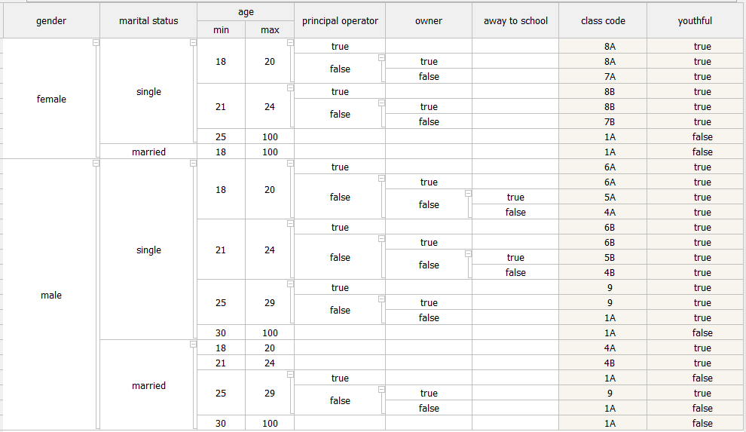
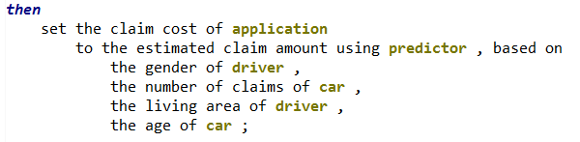
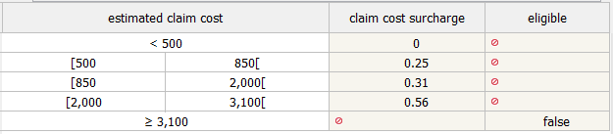
Create instance of predictor from PMML
Invoke predictor evaluation function

Slide 4
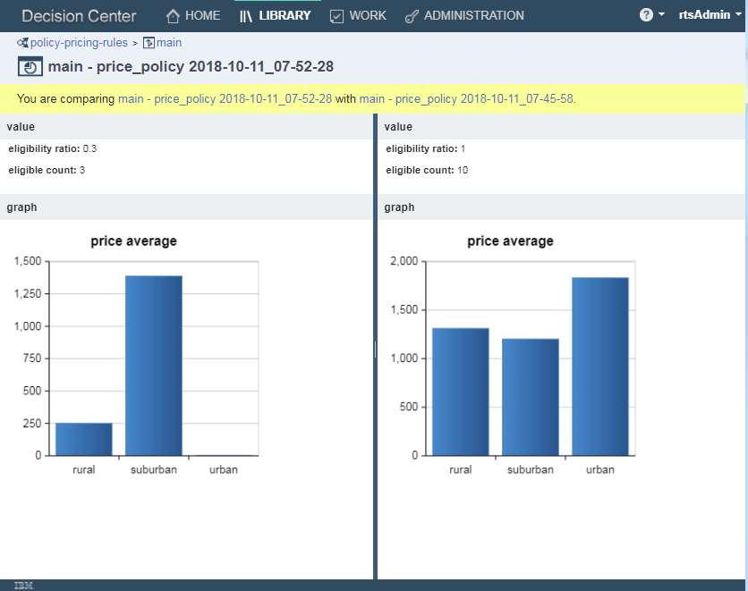
What-if: running simulations in ODM
Run scenarios
With predictor
Run scenarios
without adjustment

